Slide 1

8th Grade Math: Pre-Algebra
Unit 10, Lesson 6 Sketching Graphs of Functions Volume 2, pg. 146

Slide 2


Benchmark
MA.8.F.1.3
Analyze a real-world written description or graphical representation of a functional relationship between two quantities and identify where the function is increasing, decreasing, or constant.
volume 2, pg. 146

Slide 3
Integrated Mathematical Thinking and Reasoning Standards
MA.K12.MTR.1.1 Actively participate in effortful learning both individually and collectively.
MA.K12.MTR.4.1 Engage in discussions that reflect on the mathematical thinking of self and others.
MA.K12.MTR.7.1 Apply mathematics to real-world contexts.
volume 2, pg. 146

Slide 4

Learning Targets
I can determine the independent and dependent variables being related in a functional relationship.
I can sketch a graph from a description of a functional relationship.
volume 2, pg. 146

Slide 5

Warm-Up
volume 2, pg. 147

Slide 6
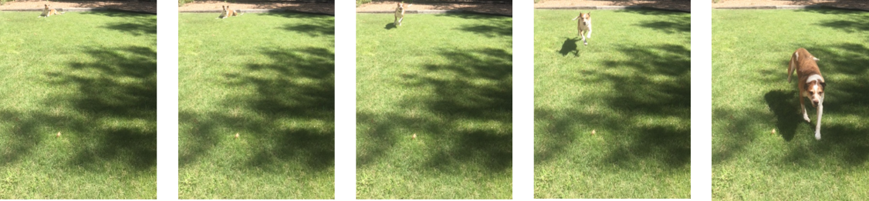
10.6.1 Warm-Up: Dog Run
Below are five pictures of a dog that were taken at equal intervals of time.
Diego and Lin drew different graphs to represent this situation.
Diego’s Graph Lin’s Graph
volume 2, pg. 147

Slide 7
They both used time as the independent variable. What represents the dependent variable on each person’s graph?
Diego’s Dependent Variable | Lin’s Dependent Variable
Explain your reasoning.
volume 2, pg. 147

Slide 8

Activity
volume 2, pg. 147

Slide 9

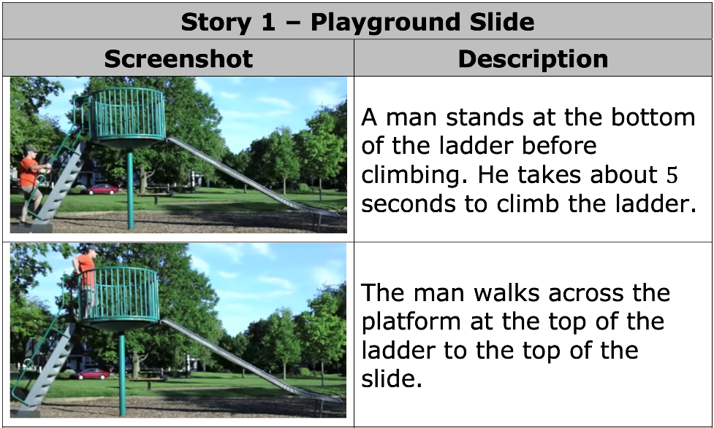
10.6.2 Activity: Graphing Stories
In this activity, several videos will be shown. If you are not able to view the videos, screenshots and brief descriptions are included for your reference.
volume 2, pg. 147

Slide 10
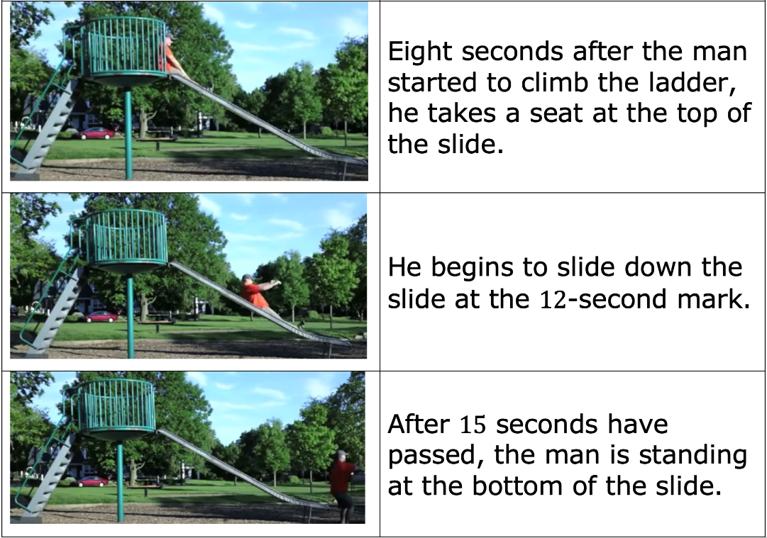
volume 2, pg. 147

Slide 11
What are some different measurements that are changing over time in this story?
Sketch the graph of the relationship between the height of the man’s waist above the ground, in feet, and time, in seconds.
Height of Waist Above the
Ground (in feet)
Time (in seconds)
volume 2, pg. 148

Slide 12
Compare your graph with your partner. Discuss your graphs and make any changes, if necessary.
Peter sketched the graph shown to represent the situation.
Height of Waist Above the Ground (in feet)
Time (in seconds)
volume 2, pg. 148

Slide 13
Compare Peter’s graph to your graph. Describe a feature Peter included on his graph that provides additional or different information than yours.
What is the domain of Peter’s graphical representation?
Discuss with your partner how the sketch of the graph would change if the 𝑦-axis measured “height of the man’s feet above the ground (feet)” instead of “height of waist.”
volume 2, pg. 148

Slide 14
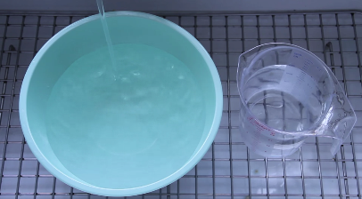
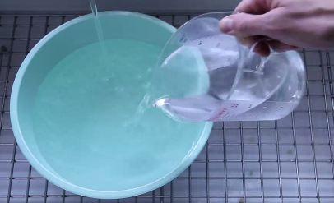
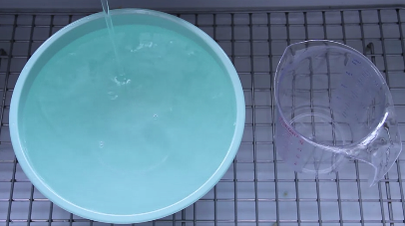
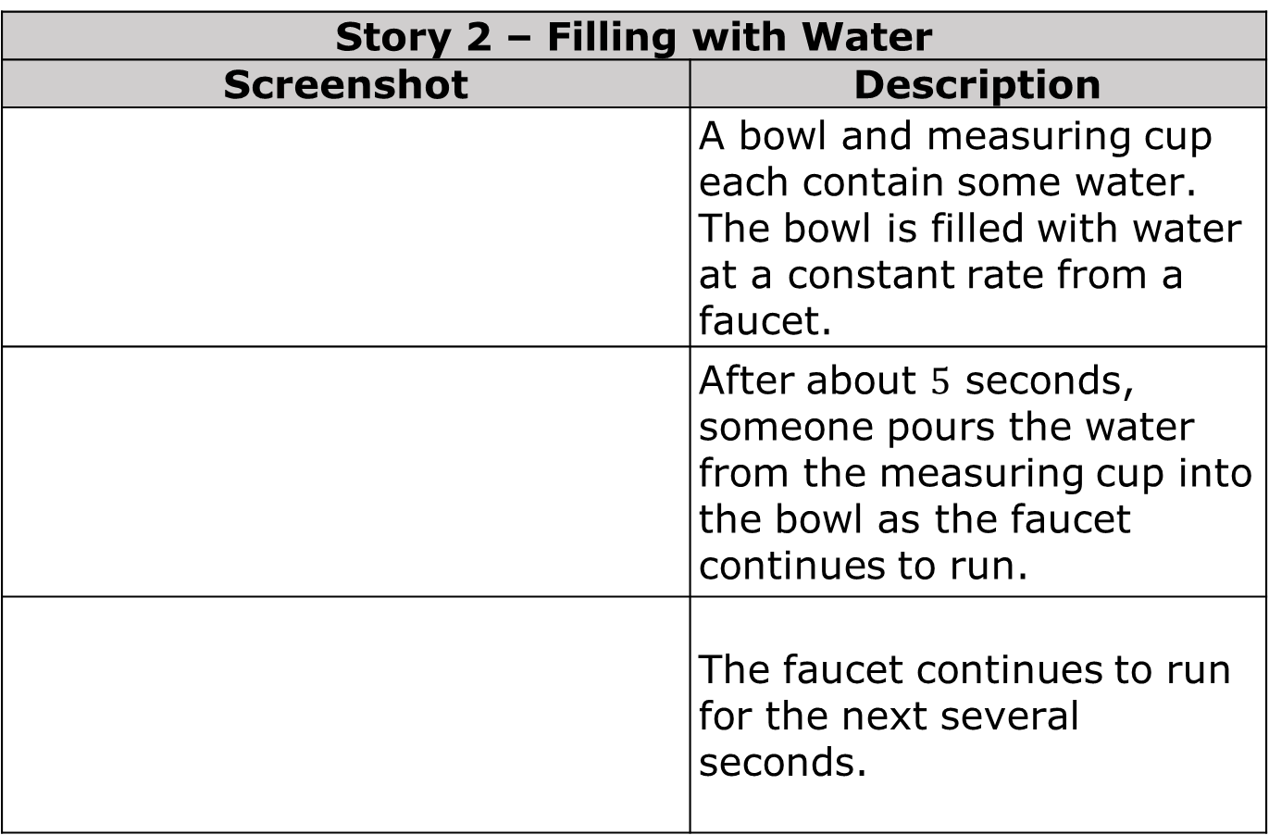
Use the screenshots and descriptions for three more stories to sketch a graph representing each story.
Story 2 – Filling with Water
Screenshot | Description
 | A bowl and measuring cup each contain some water. The bowl is filled with water at a constant rate from a faucet.
 | After about $5$ seconds, someone pours the water from the measuring cup into the bowl as the faucet continues to run.
 | The faucet continues to run for the next several seconds.
volume 2, pg. 149

Slide 15
Sketch the graph of the relationship between the amount of water in the bowl, in liters, and time, in seconds.
Water in the Bowl (in liters)
Time (in seconds)
volume 2, pg. 149

Slide 16

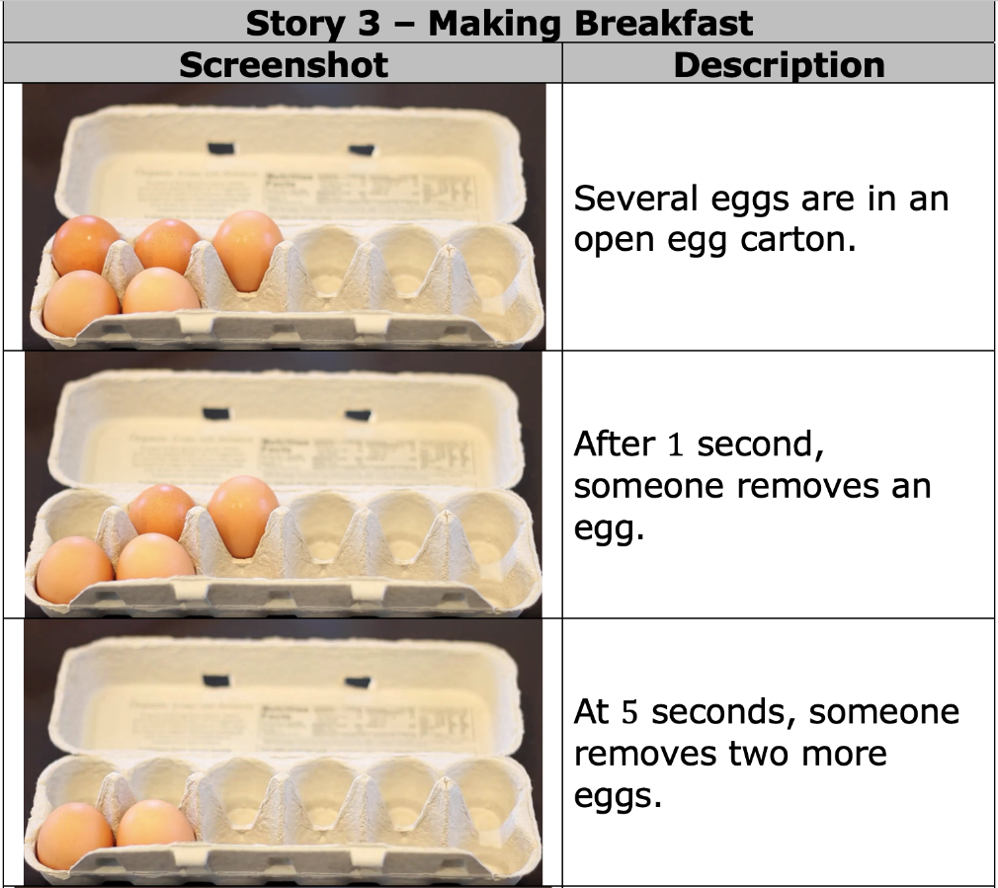
volume 2, pg. 150

Slide 17
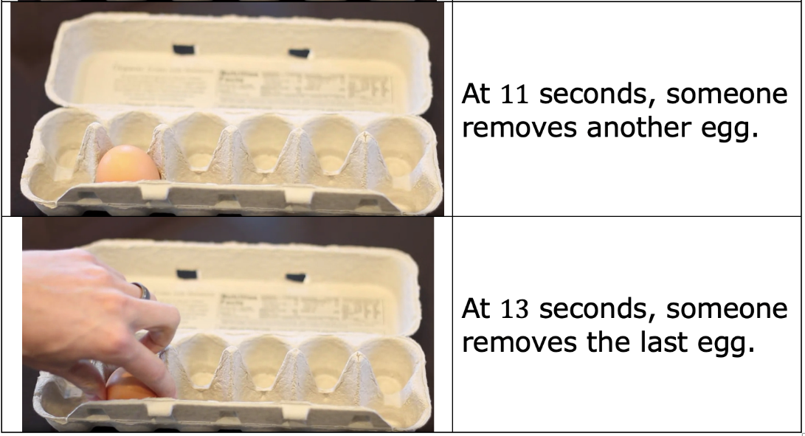
volume 2, pg. 150

Slide 18
Sketch the graph of the relationship between the number of eggs in the carton and time, in seconds.
Number of Eggs in Carton
Time (in seconds)
volume 2, pg. 150

Slide 19

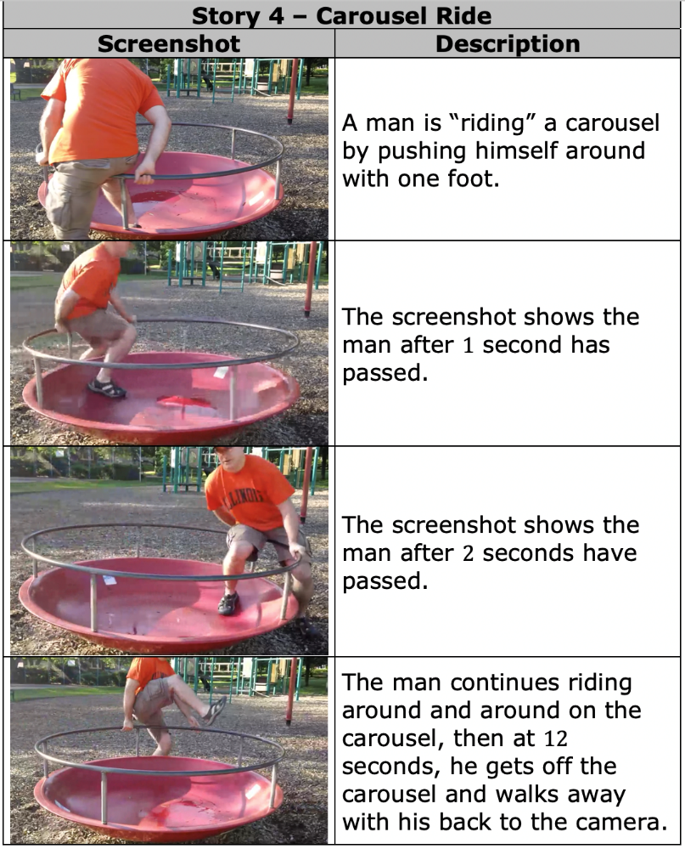
volume 2, pg. 151

Slide 20
Sketch the graph of the relationship between the distance of the man from the camera, in feet, and time, in seconds.
Distance from the Camera (in feet)
Time (in seconds)
volume 2, pg. 151

Slide 21
Compare your graphs for stories 2 and 4 with your partner. Discuss any differences and make changes to your graphs based on your discussion, if necessary.
volume 2, pg. 151

Slide 22

Try It
volume 2, pg. 152

Slide 23

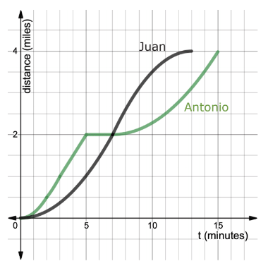
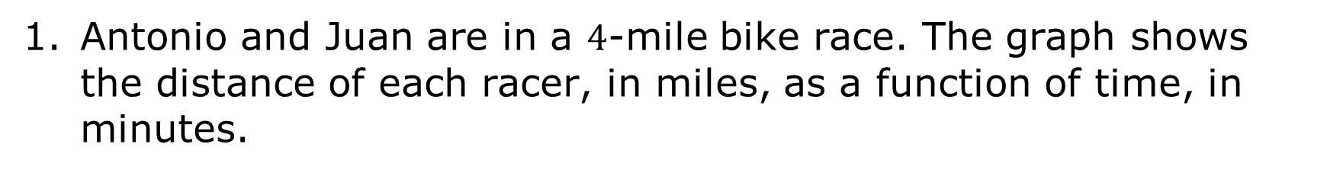
10.6.3 Try It: Create a Story
Antonio and Juan are in a $4$-mile bike race. The graph shows the distance of each racer, in miles, as a function of time, in minutes.
volume 2, pg. 152

Slide 24
Who won the race? Explain your reasoning.
Imagine you were watching the race and had to announce it over the radio. Write a story describing the race as a sports commentator would.
volume 2, pg. 152

Slide 25

Wrap-Up
volume 2, pg. 152

Slide 26
10.6.4 Wrap-Up: Cool Down
The story below describes Nima’s Saturday afternoon.
“Nima was at home. He got on his bike and rode to his friend’s house and stayed there for a while. Then, he rode home again. Later, he rode to the park. Then, he rode home again.”
volume 2, pg. 152

Slide 27
Sketch a graph of this story.
volume 2, pg. 152

Slide 28
Label the axes of your graph with the names and units of measure for the two quantities being compared.
Based on your graph, is Nima’s friend’s house or the park closer to his house? Explain how you know.
volume 2, pg. 152

